Slide 1
Introduction to Machine Learning
A. Larhlimi
Nov. 2025
Introduction to Machine Learning

Slide 2
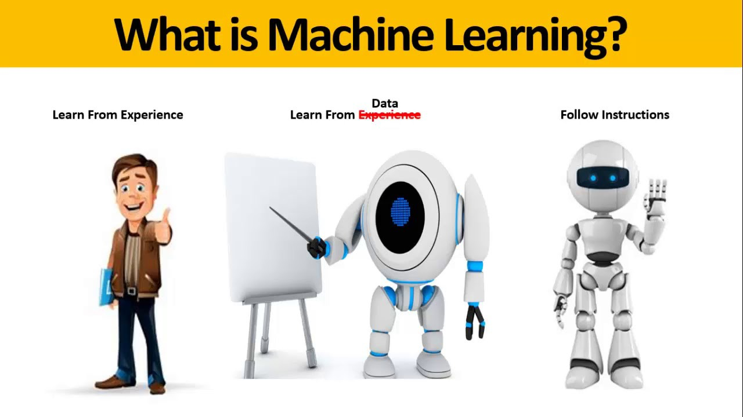
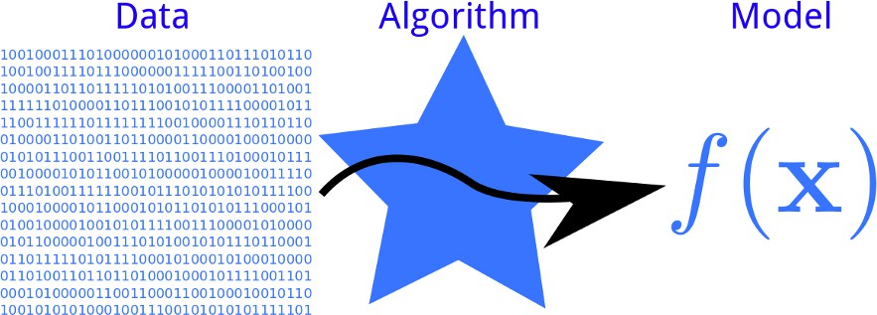
Machine Learning: introduction
Machine Learning ≡ data-based programming
ability of computers to learn how to perform tasks (classification, detection, translation. . . ) without being explicitly programmed
study of algorithms that improve their performance at some task based on experience
Introduction to Machine Learning

Slide 3
The rise
Data
Big Data : continuous increase in data generated Twitter : 50M tweets /day (=7 terabytes) Facebook : 10 terabytes /day
Youtube : 50h of uploaded videos /minute
2.9 millions of e-mails /second
Computing Power
The value-adding process
Moore’s law
Massively distributed computing
Interest: from product to customers.
Data Mining ≡ discovering patterns in large data sets
Introduction to Machine Learning

Slide 4
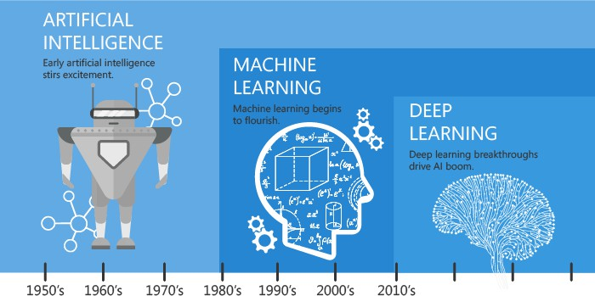
Historical perspective
Today’s AI is Deep Learning (a technique of Machine Learning)
https://blog.alore.io/machine-learning-and-artificial-intelligence/
Introduction to Machine Learning

Slide 5
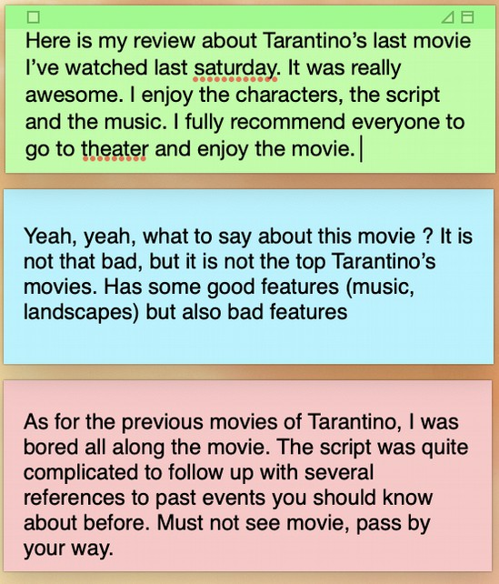


Applications: sentiment analysis
Classify stored reviews according to users’ sentiment
Score(x) > 0
Score(x) < 0
Introduction to Machine Learning

Slide 6
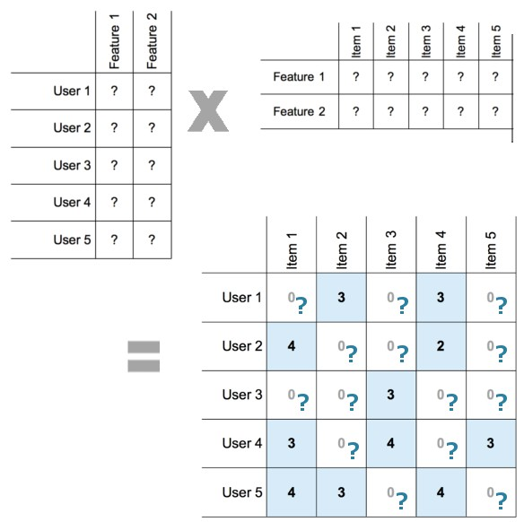
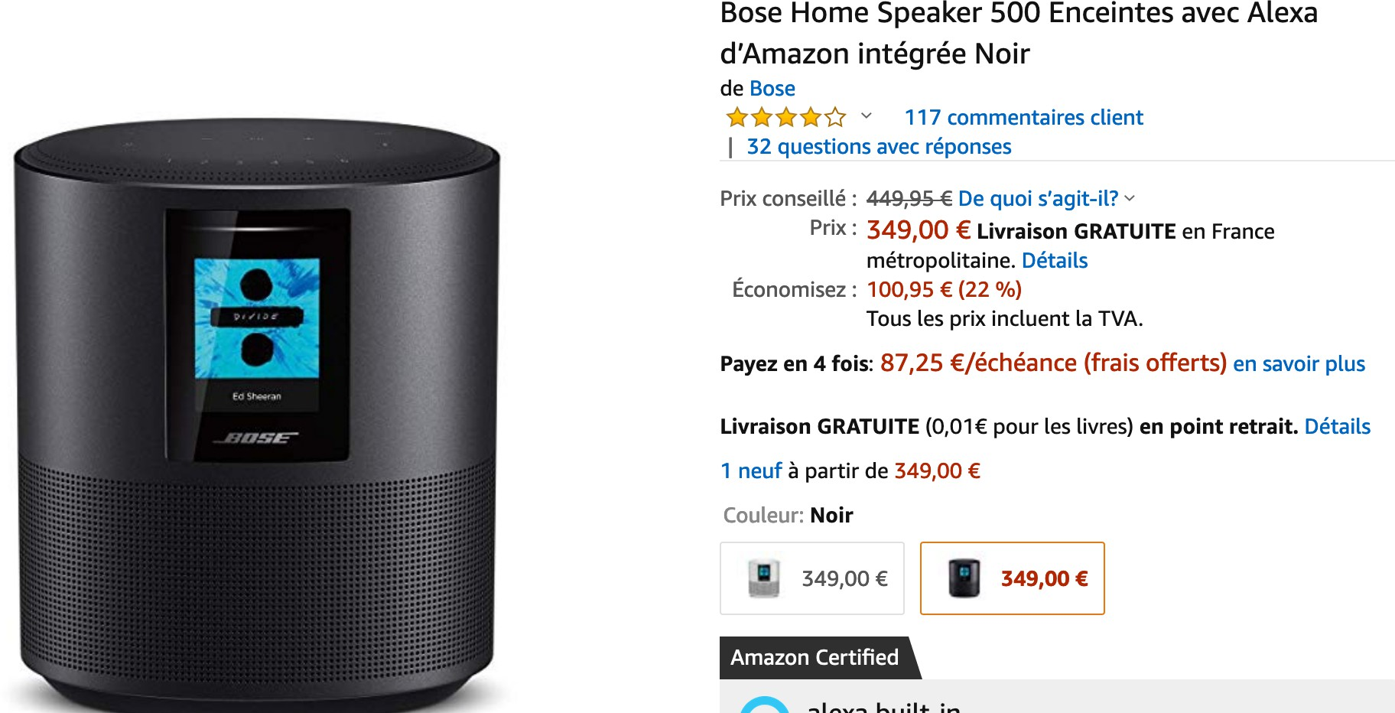

Product recommendation
Product features
Matrix factorization
Purchase history of customers
User features
https://katbailey.github.io/images/matrix_factorization.png
Purchased item
Recommended products
Introduction to Machine Learning

Slide 7
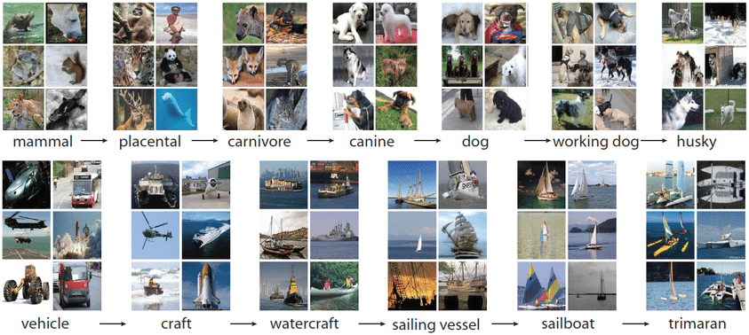
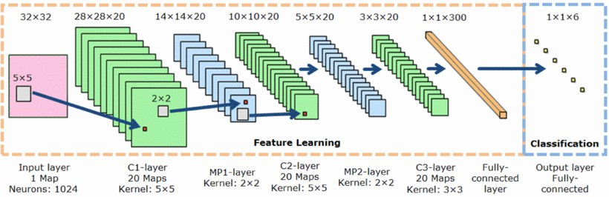
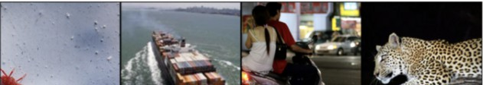
Image classification
Labeled training images
Deep classification architecture
https://www.researchgate.net/profile/Y_Nikitin/publication/270163511/figure/download/fig5/AS: 295194831409153@1447391340221/MPCNN- architecture-using-alternating-convolutional-and-max- pooling-layers-13.png
Input images and predicted category
Introduction to Machine Learning

Slide 8

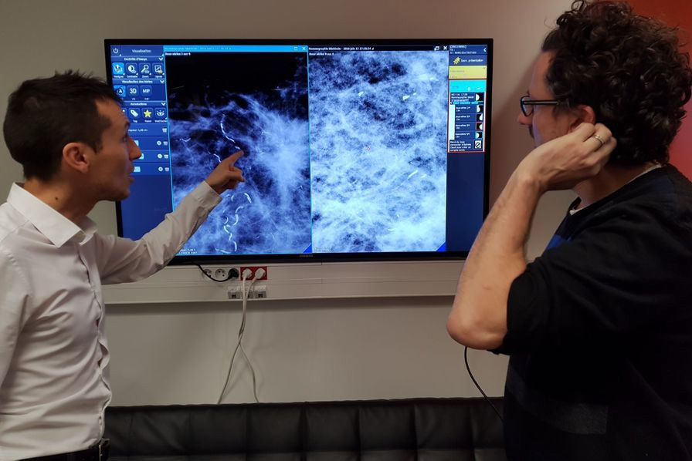
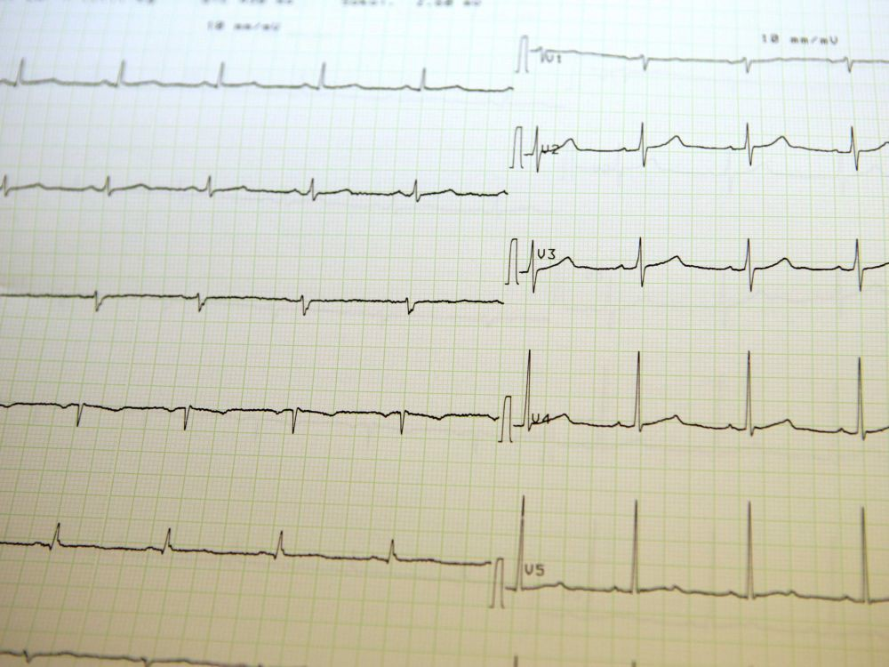
Medical diagnosis
Malignant melanoma detection
130 000 images including over 2 000 cases of cancer Error rate 28 % (human 34 %)
Digital Mammography DREAM Challenge 640 000 mammographies (1209 participants) false-positive rate decreased by 5 %
Heart rhythm analysis 500 000 ECG
accuracy 92.6 % (human 80.0 %) sensitivity of 97 %
Introduction to Machine Learning

Slide 9
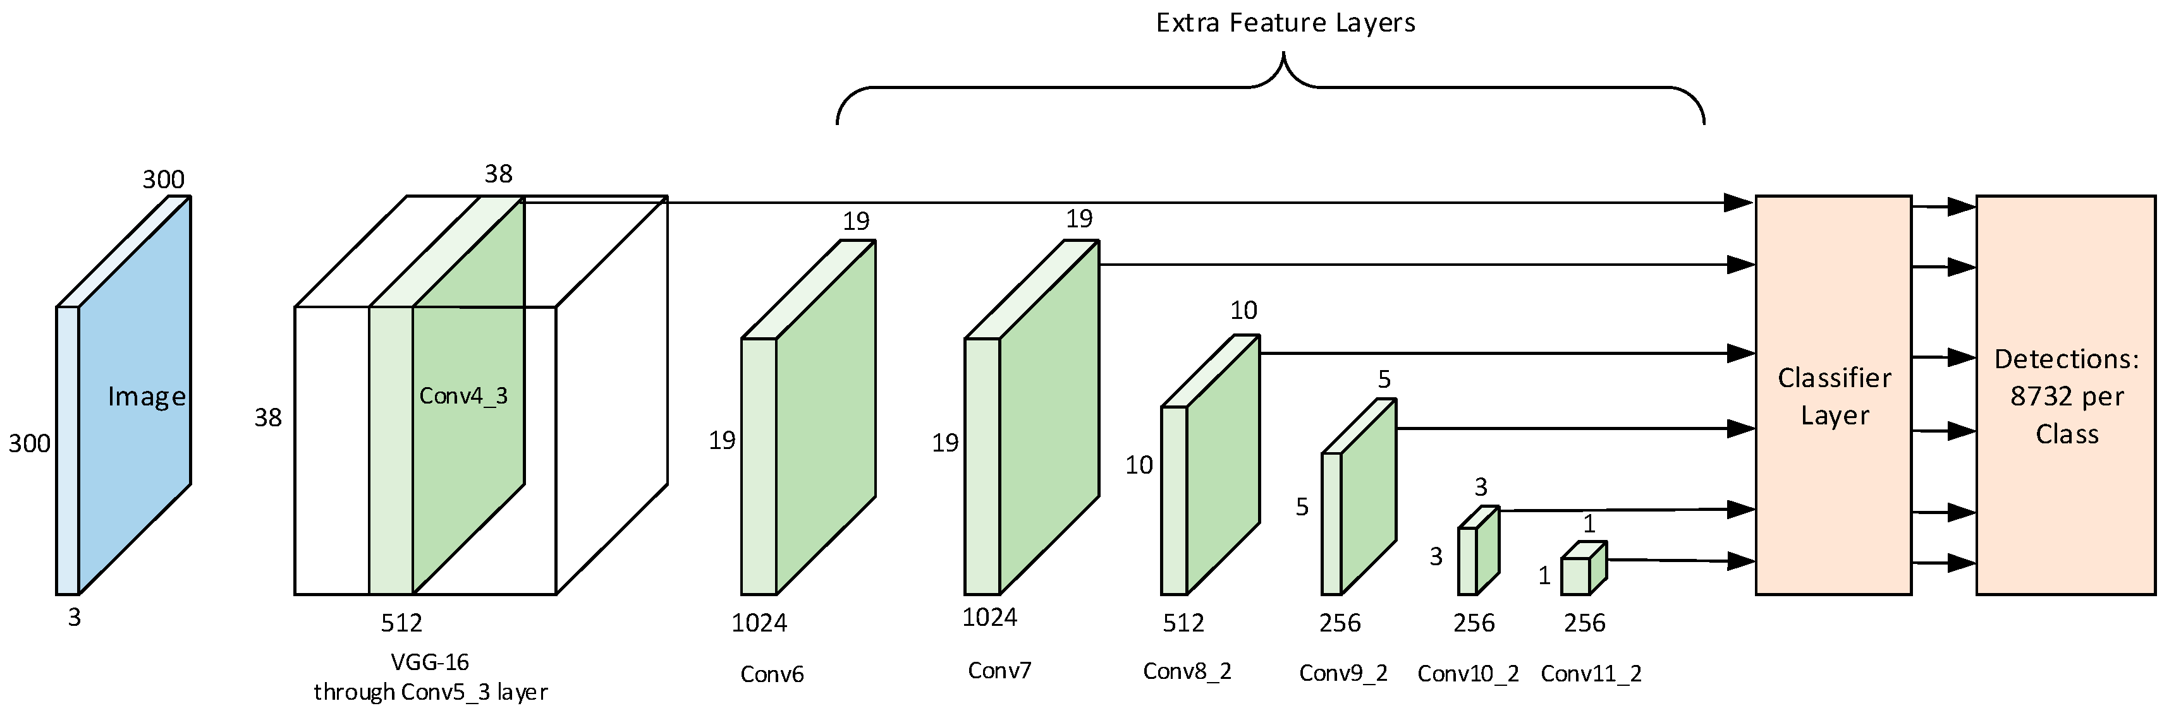
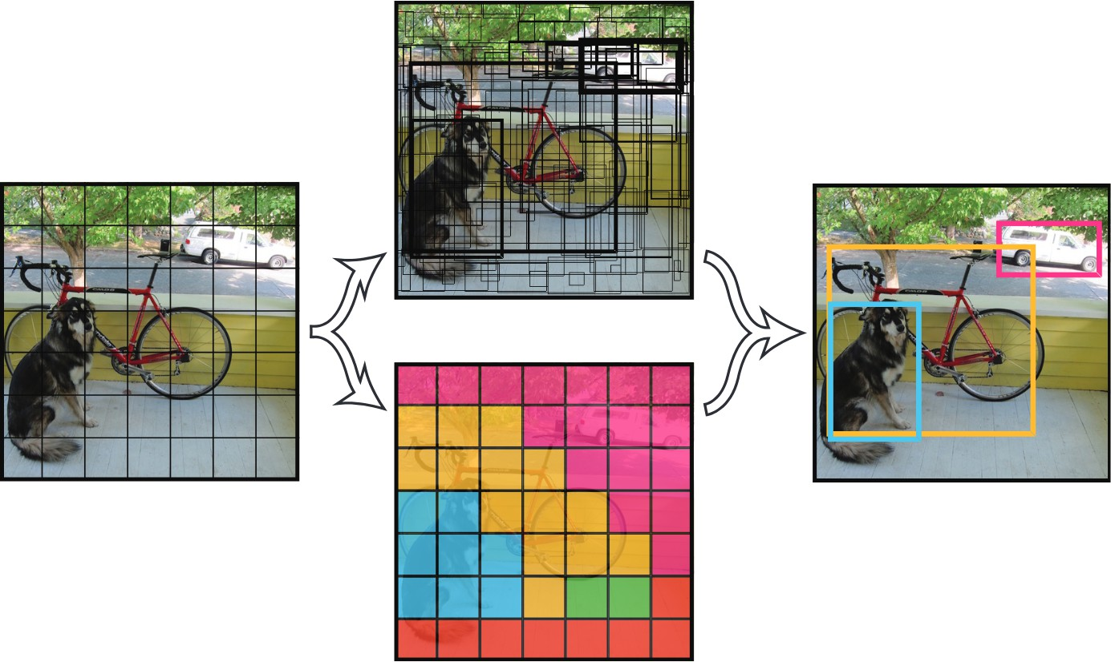
Object detection
https://www.mdpi.com/applsci/applsci-09-01128/article_deploy/html/images/applsci-09-01128-g004.pn
https://arxiv.org/pdf/1506.02640.pdf
Introduction to Machine Learning

Slide 10
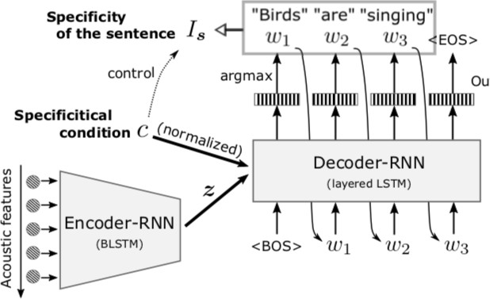
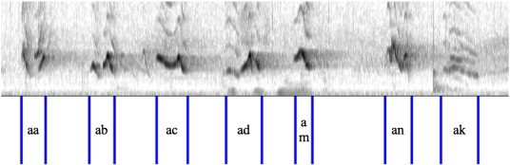
Audio captioning
https://ars.els-cdn.com/content/image/1-s2.0-S1574954115000151-gr1.jpg
Introduction to Machine Learning

Slide 11
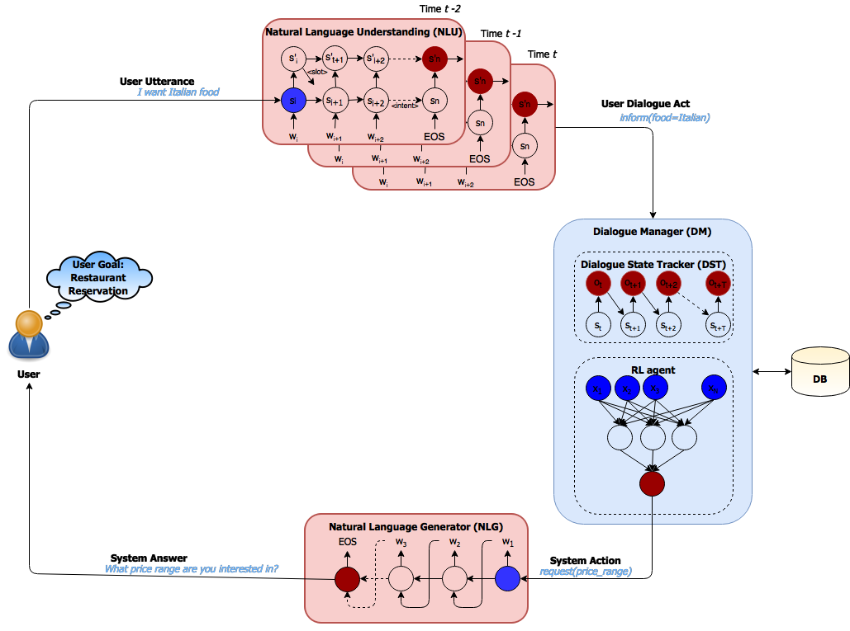
Chatbot
https://miro.medium.com/max/2058/1*LF5T9fsr4w2EqyFJkb- gng.png
Introduction to Machine Learning

Slide 12
Implementing a Machine Learning project
Data Strength-ening
Cleaning Organizing Aggregation Management of errors
. . .
Data Gathering
Sensors Transactions Web-clicks,logs Mobility
Open data
Docs
. . .
Data engineering
Real World
Business
Industries Insurance Internet
Social Networks
Medical
. . .
Exploration Representation Display
Machine Learning
Data Mining
. . .
Interpretation Pattern of interests
Strategic decision
Valuation
. . .
Introduction to Machine Learning

Slide 13
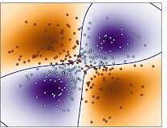












Chain of the data engineering process
Evaluate the model
Pre-processing
Train the model
Data
Model
1
Understand and specify project goals
Pre-processing/visualize/analyze data
Which ML problem is it? Design a solving approach Evaluate its performance Go to to 2) if needed
2
 |  | Y
 | 1 | 1
 | 1 |  |  | 1 | 1
 |  | ? | 1 | 1
1 |  | 1
 |  |  |  | 1
 |  | 1 | 1
3
4
5
1
6
Course Goal: Study the steps from 2 to 5
Introduction to Machine Learning

Slide 14
The data
Information (past experience) are examples with attributes
Assume the data set consists of N samples
Attributes
An attribute is a property or characteristic of a phenomenon being observed. Also termed feature or variable
It is an entity characterising an object; it is made up of attributes. Synonyms : instance, point, vector (usually in R^{d} )
Sample
Introduction to Machine Learning

Slide 15
Data : visualization
⁻---₋₋Fe₋atures Points x -₋ | citric acid residual sugar | chlorides | sulfur dioxide
1
2
3
Point x ∈ R⁴
0
0
0.04
1.9
2.6
2.3
0.076
0.098
0.092
11
25
15
0.56
1.9
0.075
17
5
6
7
8
9
10
0
0
0.06
0.02
0.36
0.08
1.9
1.8
1.6
2
2.8
1.8
0.076
0.075
0.069
0.073
0.071
0.097
11
13
15
9
17
15
0.1
0.095
0.09
Variable 3 : Chlorides
Points
Moyenne des points
0.085
0.08
0.075
0.07
0.065
1.5
2 2.5
Variable 2 : Residual Sugar
3
Introduction to Machine Learning

Slide 16
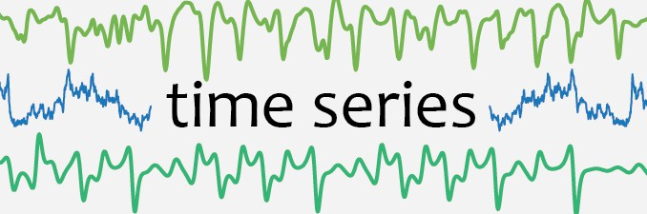
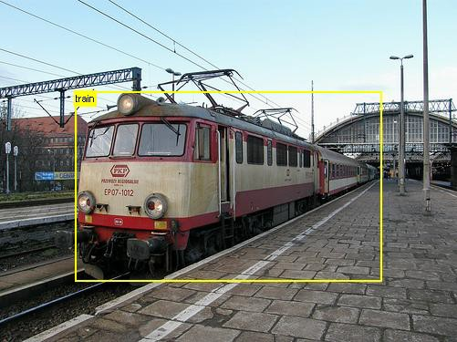
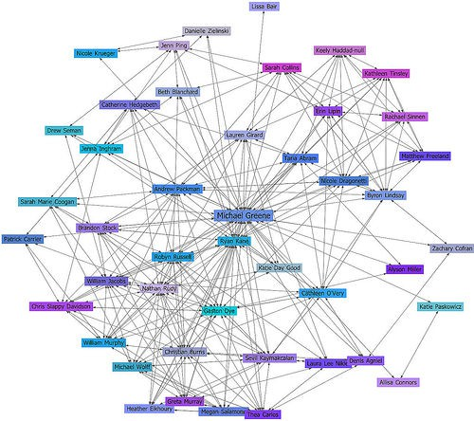
Data types
Sensors →
Quantitative and qualitative variables, ordinales, nominals String
Time Series 2D Data
2D Data + time Graphs
Logs, coupons. . .
Expected output prediction
Text → Speech → Images → Videos → Networks → Stream → Labels →
Introduction to Machine Learning

Slide 17
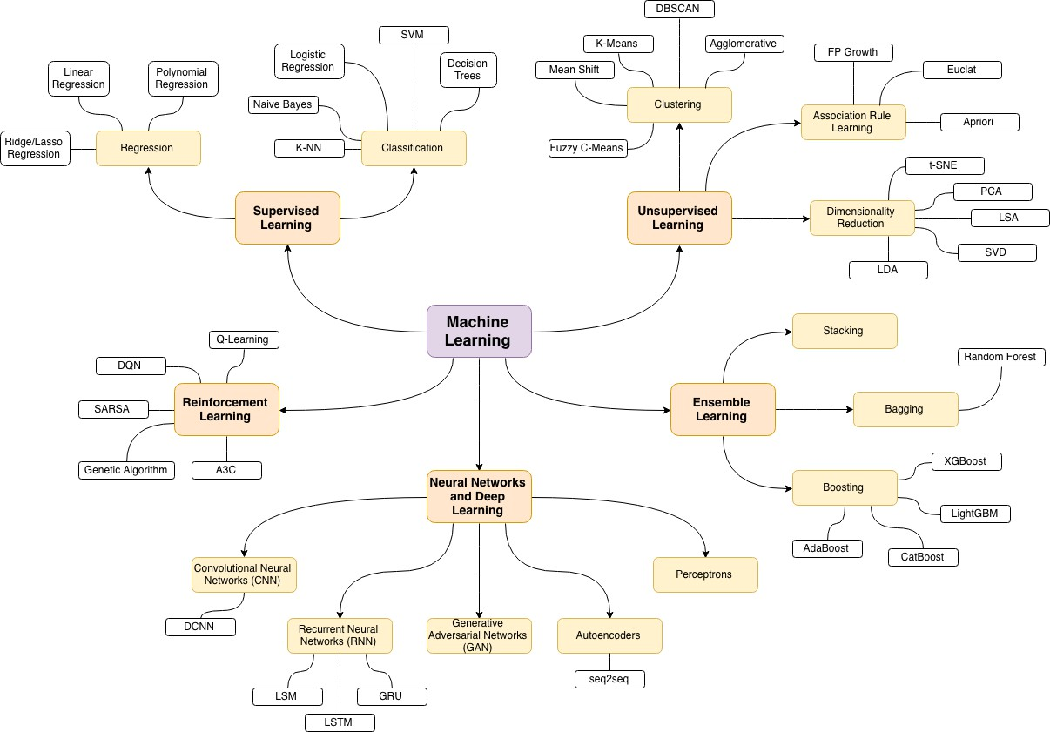
Approaches of Machine Learning
Introduction to Machine Learning

Slide 18
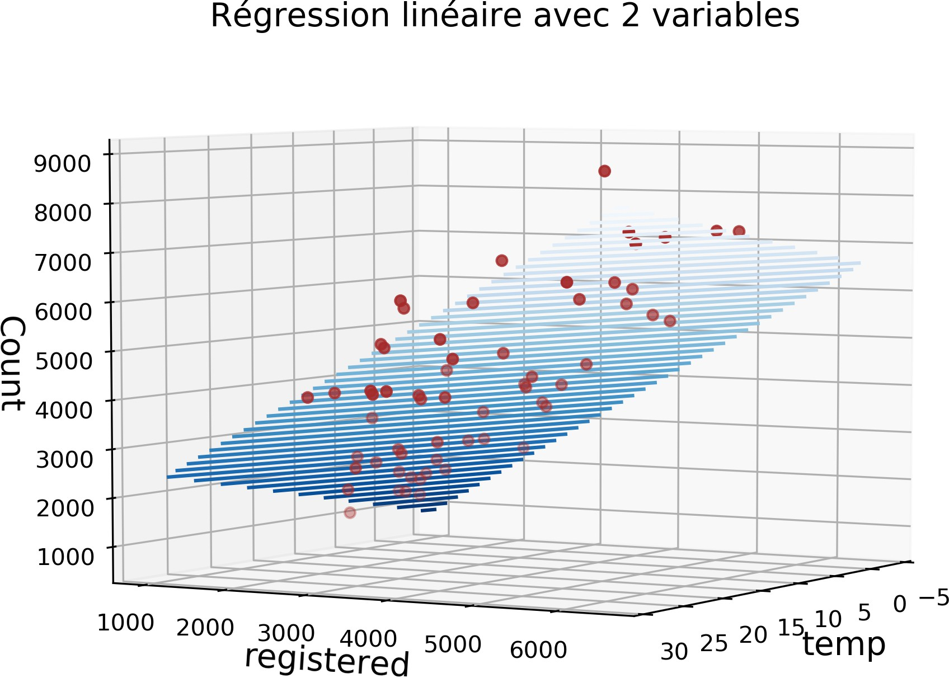
Supervised learning
Principle
Given a set of N training examples {(x_{i}, y_{i} ) ∈ X × Y, i = · · · , N}, we want to estimate a prediction function y = f (x ).
The supervision comes from the label knowledge
Image classification, object detection, stock price prediction . . .
Examples
Introduction to Machine Learning

Slide 19
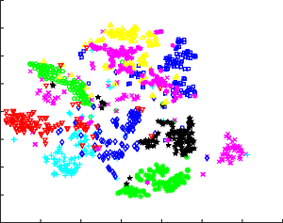
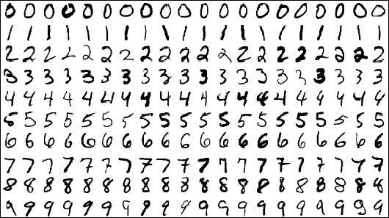
Unsupervised learning
Principle
Only the {x_{i} ∈ X , i = · · · , N} are available. We aim to describe how data is organized and extract homogeneous subsets from it.
Applications: Customers segmentation, image segmentation, data visualization, categorization of similar documents . . .
Examples
80
60
7
7 ⁷ 7⁷⁷⁷
²⁷7⁷⁷⁷7⁷⁷⁷⁷⁷⁷⁷⁷ ⁷7 ⁹⁹⁴⁹
⁷⁷⁷⁷⁷7⁷7⁷ 7 ⁷ ⁷
⁷ ⁷⁷⁷⁷ ⁷ ⁷⁷ ⁷7 ⁷ ⁴4⁴4
⁷ ⁹99 ⁹ 7⁷⁷⁷⁷ ⁹ ⁴
₄⁸ ₃⁹9⁹9 9₉ ₉ ₉ 9₉ ⁹9
₄44 ₄
40
4
9₉ ₉9₉9 ⁹ ⁹9⁹ ₇₇
₄ 4₄4₄⁴⁴⁴4⁴₄₄
7
⁴ ₉⁹ ⁹ ⁹9⁹9 ₇⁷ 444₄₄₄ ⁴⁴4 ⁴
¹¹1¹1¹¹¹1 ⁸⁷
² ₇₇ ⁹ ¹7₇⁷77 ₄7⁷⁷ ₄ ₄⁴₄⁴4⁴⁴ ⁴
11111111 11 2 7 799 9999997 7 79 ⁴9⁴⁴⁴ ⁴⁴⁴⁴⁴
² 11¹¹ ¹¹1¹¹ ⁵⁹⁹ ⁹⁹⁹ ⁴ 4⁴ 9
20
1¹₁¹ 11 ₇ ₁ 2⁷ ₂
⁴ ⁴⁴⁹⁷ ⁹⁹9 ² ⁷ 44
² ¹¹¹¹¹¹¹¹1¹¹ ¹¹ ¹ 4 ³ ² 44 ⁷⁷⁹⁹⁹⁹⁹⁹⁹ 4⁴4⁴4
⁸ ⁶⁶ ¹¹¹¹11¹7 ²3³⁷ ⁴⁹ ⁹³ ⁹⁹⁹ ⁹ ⁹⁹ ⁴9⁴ 4⁴
₂ ₂ ₂ 1¹¹1₁1
⁴ ⁸ ⁹ ⁴⁹4 ⁴44⁴⁴⁴⁴⁴
² ² ¹¹¹¹¹¹1 ⁷ ²²2 ² 2 7 ⁴ ⁵⁹ 9 ⁴4 9⁴
2 ² 22 1 6 2 5
²2 2² ¹¹¹¹¹1¹²
2²² ²²
5⁹
²² ⁸ ⁸¹¹¹¹1 ⁶⁶²
6⁰⁷⁷ ⁹
4
⁰ ⁸ ⁸ 8 ⁵ ⁵ ²⁶ ¹² 55⁵⁸⁵⁸
⁸ ⁸⁸⁸⁸⁸⁸ ⁸⁸ ⁸⁸⁸ ³ 8 ⁹³ ¹³ ⁵⁵⁵⁵⁵⁵ ⁶
8
⁸ 8⁸8⁸ ⁸8⁸⁸
55⁵ ⁵⁵⁵⁵
³ 0² 6
⁸8 ⁸ ⁸⁸8 ⁸⁸ ⁸ 8 8⁸ ⁵⁸8 8 ⁹⁹ ⁵ 55⁵⁵⁵
⁶⁶ ⁶⁶6
4 ⁶
⁸8⁸⁸⁸⁸⁸⁸8 ⁸⁸ ⁸⁸⁸ 8 ⁸⁸ ⁸⁸ ⁸⁵ ⁵ 55⁵5⁵⁵
⁸⁸⁸⁸ ⁸⁸ ⁸⁸ ⁸ 5⁵ ³ ⁸⁸ 35 5⁵⁵⁵
₈56 ⁶ ⁶
⁸ ² 8
³³³³⁵3³ ⁸³⁵ ³5
₂2
-20 3
⁸ 5 ³ ³ ³³ ⁵ ⁵⁵ 5⁵ ⁵
6 ⁶ 49⁶
6
² 2
2 ⁸ ₃ ₃33 ₃ ₅ ⁵ 5 ₅ ₅⁵ ⁶⁶ ⁶ 6 6⁶
² ² ²2
3
⁸ 8 8
3 ³⁵⁹
5 5 ⁶ ⁶
⁶ 6⁶
²²²²²²²²²2
₃ 3³³3
³ ³³ 5⁵⁵5⁵55⁵ ⁶ 6⁶ 2²²² ²²²²23
3₃₃ ₃ ₃ 3 ₃33 ⁵³ ⁵⁵ 5 ⁵⁵⁵⁵
3
⁰ ⁵² 22 ²2²²² ²²
-40
³ ³³³ ³ ³ ³3 3
0
²² 22 ²
³³3³ 3³ 5 0 ⁰
³³³³³3³³ ⁵5 ⁰ ⁰ 0⁰⁰⁰⁰⁰⁰ ⁰
³³ 3³³³ ⁵5
00 ⁰⁰⁰0⁰ ⁰ ⁰⁰⁰⁰⁰⁰0 ²
³ ⁶ ⁰ ⁰⁰ ⁰0⁰⁰0⁰⁰⁰⁰⁰⁰⁰⁰⁰⁰
0⁶⁰ ⁹ ⁰ ⁰⁰ ⁰⁰0 ⁰⁰
0
-60
0⁰⁰ ⁰⁰⁰⁰⁰⁰⁰ ⁰⁰ ⁰⁰⁰⁰⁰⁰⁰
⁰ ⁰⁰⁰⁰⁰⁰ 0 ⁰⁰
-80
-60
-40
-20
0
20
40
60
80
Introduction to Machine Learning

Slide 20
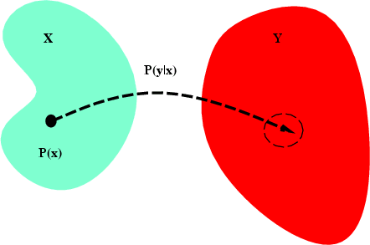
Supervised learning : concept
Let X and Y be two sets. Assume p(X, Y ) the joint probability distribution of (X, Y ) ∈ X × Y.
Goal : find a prediction function f : X → Y which correctly estimates the output y corresponding to x .
f belongs to a space H called hypothesis class. Example of H : set of polynomial functions
Introduction to Machine Learning

Slide 21
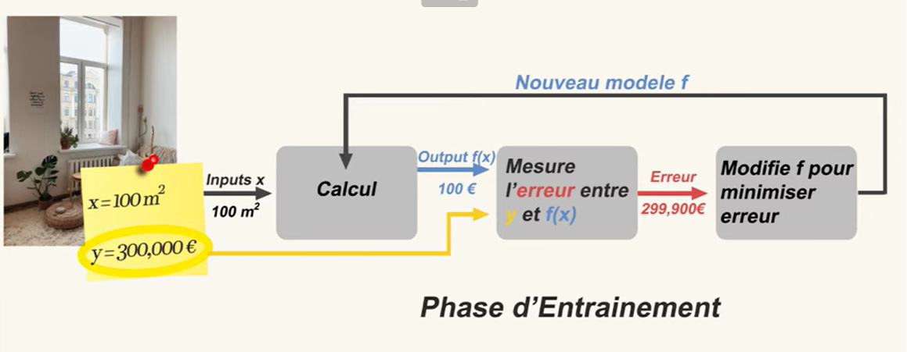

Slide 22
Supervised learning: principle
Loss function L(Y , f (X ))
evaluates how ”close” is the prediction f (x ) to the true label y
�
0 if y = f (x )
≥ 0 if y /= f (x )
it penalizes errors: L(y, f (x )) =
True risk (expected prediction error)
R(f ) = E_{(X,Y )}[L(Y , f (X ))] = ^{r} L(y, f (x ))p(x, y )dxdy
X×Y
Objective
Identify the prediction function which minimizes the true risk i.e.
f * = arg min R(f )
f ∈H
Introduction to Machine Learning

Slide 23
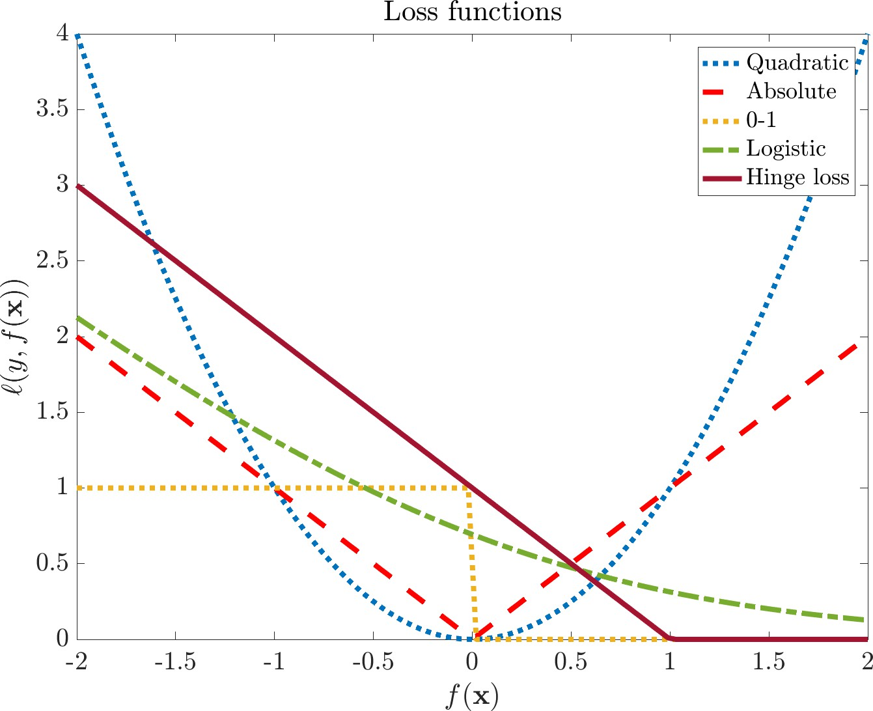
Loss functions
Quadratic loss : L(Y , f (X )) = (Y − f (X ))²
fl₁ loss (absolute deviation): L(Y , f (X )) = |Y − f (X )|
�
if y = f (x )
otherwise
0 − 1 loss: L(y, f (x )) =
Hinge loss: L(y, f (x )) = max(0, 1 − yf (x ))
Introduction to Machine Learning

Slide 24
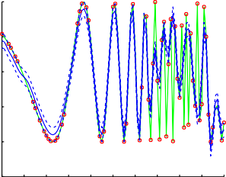
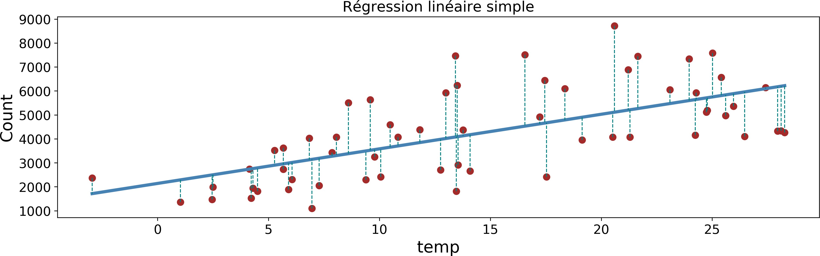
Some supervised learning problems
Regression
Support Vector Machine Regression
1
We talk about regression when
Y is a subset of R^{d} .
Usual related loss function: quadratic loss (y − f (x ))²
0.5
0
y
−0.5
−1
−1.5
0 0.5 1 1.5 2 2.5 3 3.5 4 4.5 5
x
Introduction to Machine Learning

Slide 25
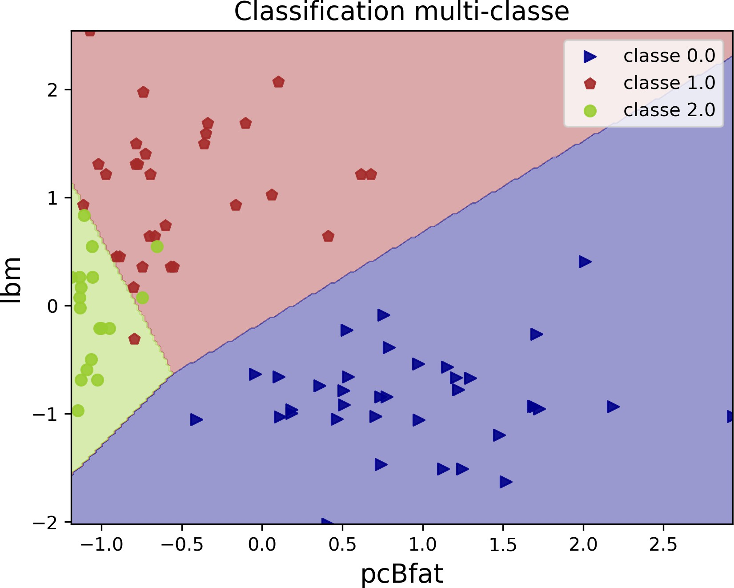
Some supervised learning problems
Classification
Output space Y is an un-ordered discrete set Binary classification: card (Y) = 2
Example: Y = {−1, 1}
Loss functions: 0-1 loss, hinge loss
Multiclass classification: card (Y) > 2
Example: Y = {1, 2, · · · , K }
Introduction to Machine Learning

Slide 26
From true risk to empirical risk
Minimizing the true risk is not doable (in allmost all practical applications)
The joint distribution p(X, Y ) is unknown!
Only a finite training set {(x_{i}, y_{i} ) ∈ X × Y}^{N} is available
i =1
Empirical risk
N
1
N
�
R (f ) =
L(y , f (x ))
emp
i i
i =1
Empirical risk minimization
f^{ˆ} = arg min R_{emp} (f )
f ∈H
Introduction to Machine Learning

Slide 27
Overfitting
Overfitting
Empirical risk is not appropriate for model selection: if H is large enough,
R_{emp} (f ) → 0 but the generalized error (true risk) is high.
Erreur de prediction
Ensemble de Test
Ensemble d’apprentissage
Faible
Elevé
Complexité du modèle
Introduction to Machine Learning

Slide 28
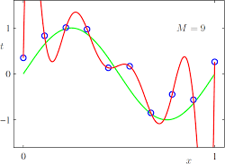
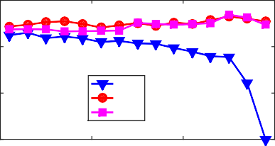
Illustration of overfitting
0.3
0.2
Risque empirique
0.1
App Val Test
0
30
20 10
Valeurs decroissantes de k
0
https:
//www.cs.princeton.edu/courses/archive/spring16/ cos495/slides/ML_basics_lecture6_overfitting.pdf
Introduction to Machine Learning

Slide 29
Model selection
Find in H the best function f that learned based on the training set will well generalize (low true risk)
Example : We are looking for a polynomial function of degree α
minimizing the risk : R
Goal :
�
(f ) =
N
i =1
(y_{i} − f_{α}(x_{i} ))².
emp α
1
propose a model estimation method in order to choose (approximately) the best model belonging to H .
once the model is selected, estimate its generalization error.
2
Introduction to Machine Learning

Slide 30
Model selection : basic approach
Case 1 : N is really big (large scale D_{N} )
Données disponibles
Apprentissage { X _{app} ,Y _{app} }
Validation ^{{ X} val ^{,Y} val ^{} Test { X test , Y test }}
Randomly split D_{N} = D_{train} ∪ D_{val} ∪ D_{test}
For each α, train f_{α} based on D_{train}
1
2
�
3
Evaluating its performance on D_{val} R =
1
^{N}val
L(y_{i}, f (x_{i} ))
val
i ∈D
val
Select the model with the best performance on D_{val}
Test selected model on D_{test}
4
5
Note
D_{test} is used once!
Introduction to Machine Learning

Slide 31
Model selection : Cross-validation
Case 2 : Small or medium scale D_{N}
Estimate the generalization error by re-sampling. Principle
Split D_{N} into K sets of equal size.
For each k = 1, · · · , K , train a model by using the K − 1 remaining sets and evaluate the model on the k-th part.
Average the K error estimates obtained to have the cross-validation error.
1
2
3
Validation | Apprentissage | Test
Apprentissage | Validation | Apprentissage | Test
Apprentissage | Validation | Test
Introduction to Machine Learning

Slide 32
Conclusions
To successfully carry out an automatic data processing project
Clearly identify and spell out the needs.
Create or obtain data representative of the problem Identify the context of learning
Analyze and reduce data size
Choose an algorithm and/or a space of hypotheses
Choose a model by applying the algorithm to pre-processed data Validate the performance of the method
Introduction to Machine Learning

Slide 33


Slide 34
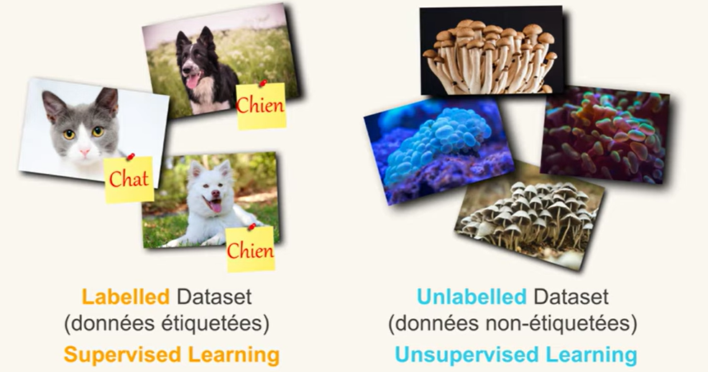

Slide 35
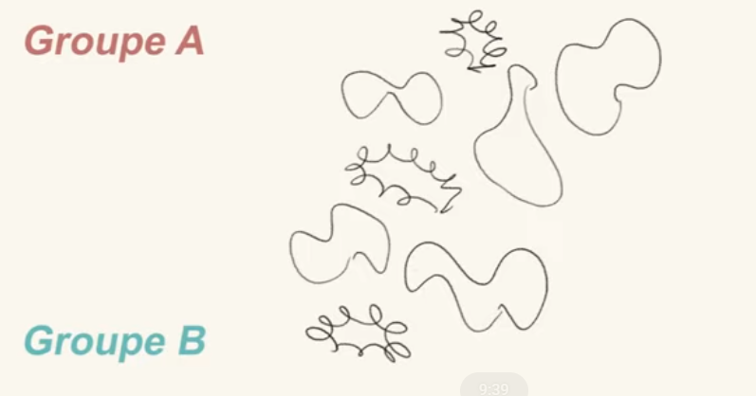

Slide 36
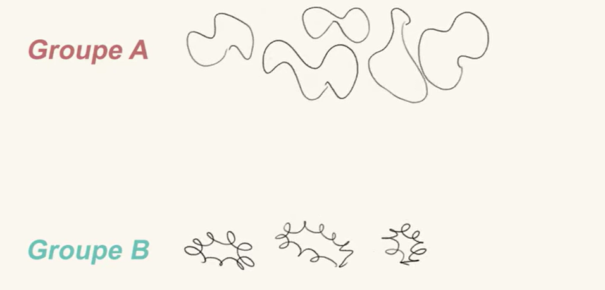

Slide 37
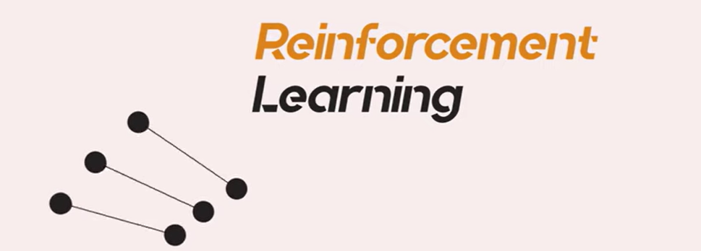

Slide 38


Slide 39
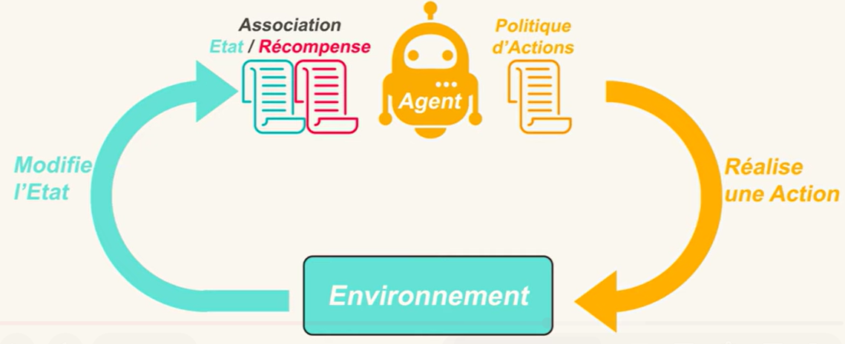

Slide 40
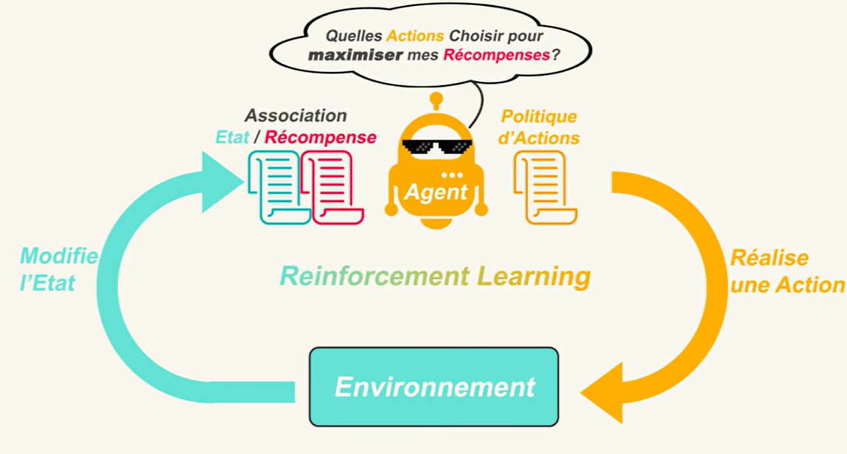

Slide 41
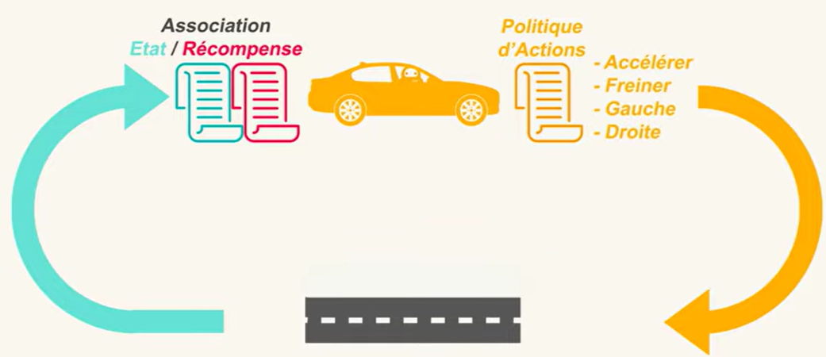

Slide 42
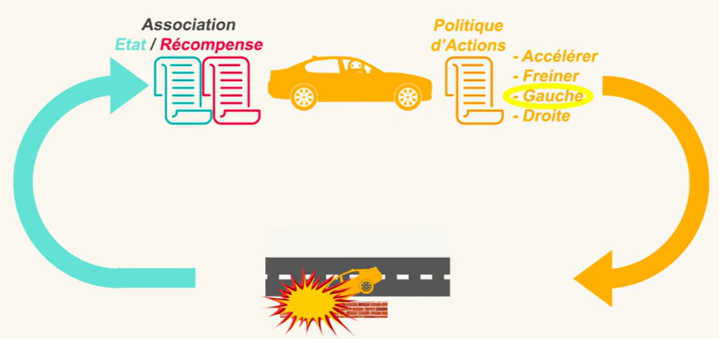

Slide 43
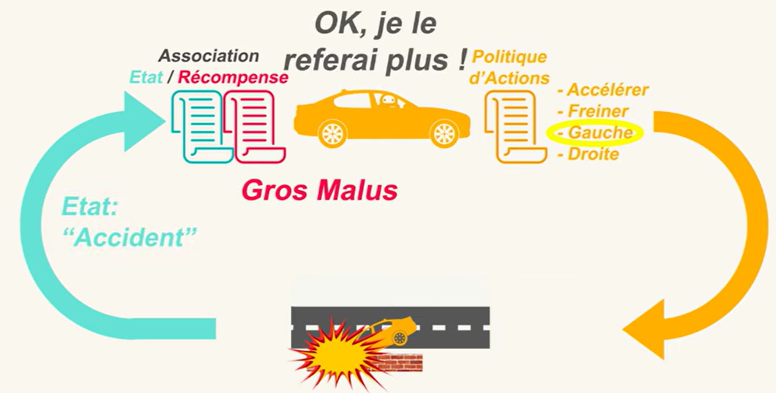

Slide 44
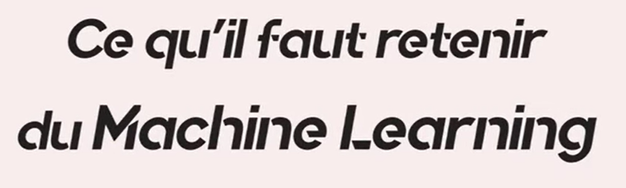

Slide 45
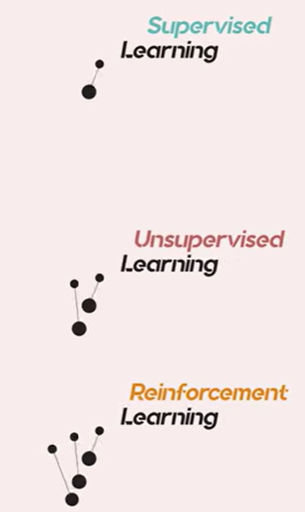
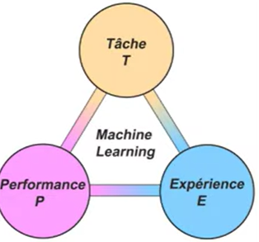

Slide 46
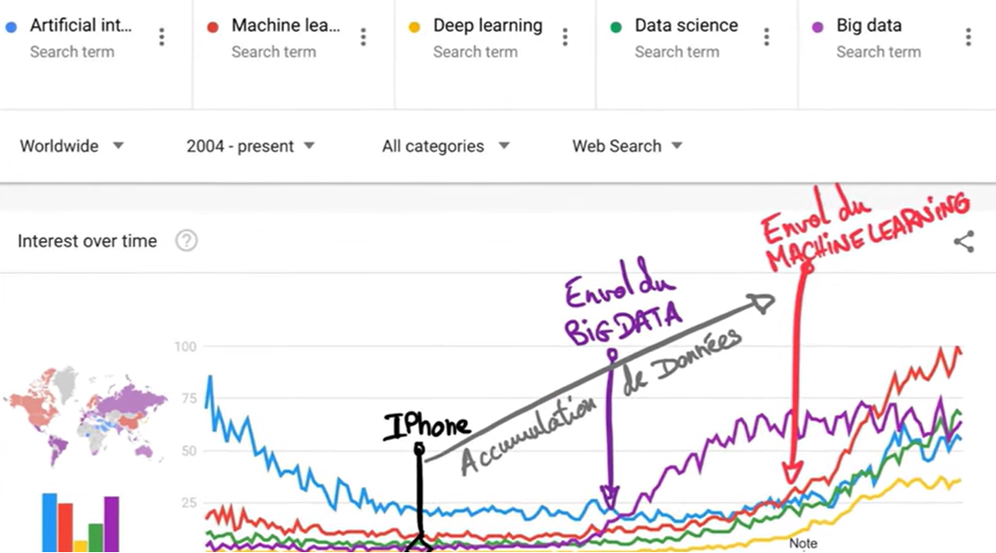

Slide 47
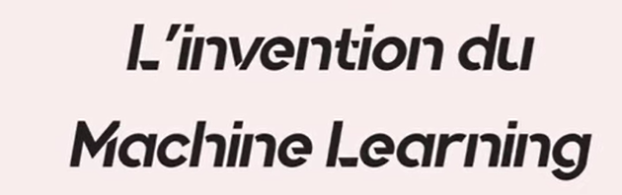

Slide 48
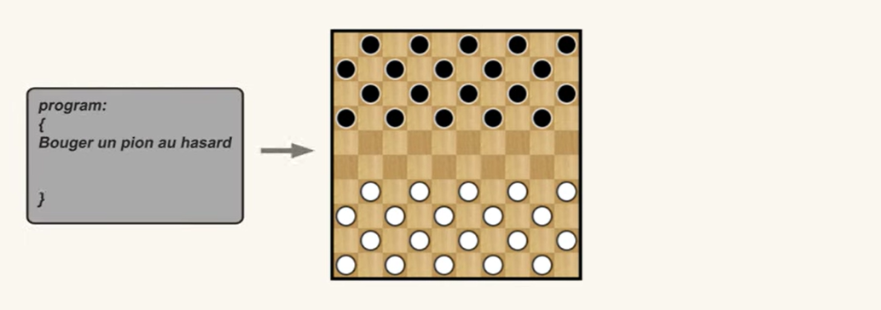

Slide 49
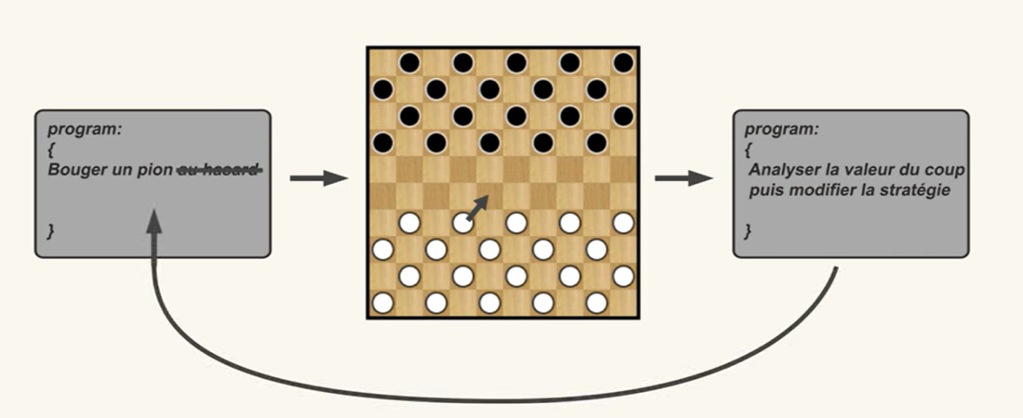

Slide 50
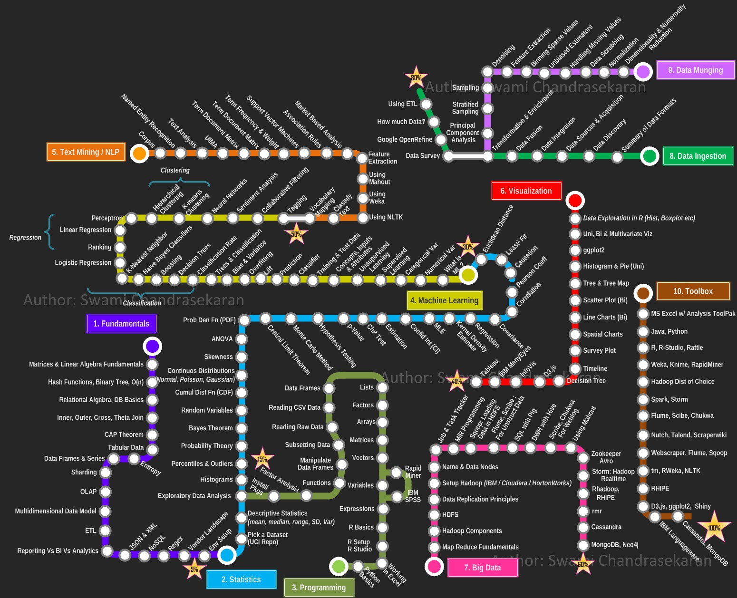
Au final ...
Find your way. . .
Introduction to Machine Learning

